Slide 1
Governance and Compliance

Slide 2
Management Groups
Organizational alignment for your Azure subscriptions through custom hierarchies and grouping
Targeting of policies and spend budgets across subscriptions and inheritance down the hierarchies
Compliance and cost reporting by organization

Slide 3
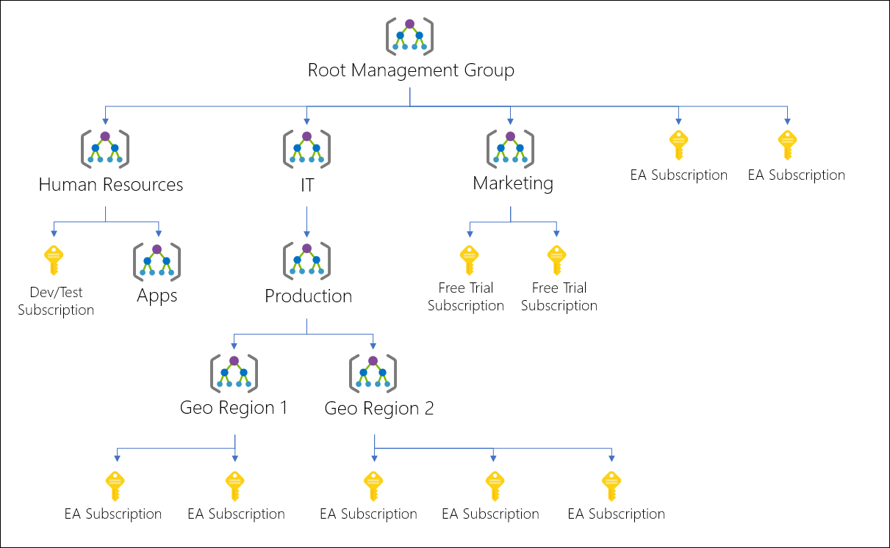

Slide 4
Azure Subscriptions
Logical unit of Azure services that is linked to an Azure account.
Users, groups and service principles
Azure resources in resource groups
Authentication
& Authorization
Azure Subscriptions
Azure Active Directory

Slide 5
Getting a Subscription
Enterprise Agreement – Upfront monetary commitment
Resellers – Open Licensing Program
Partners – Microsoft partner who can design and implement azure cloud solutions
Personal
Free Trial Account
Pay As You Go
Student Subscription

Slide 6
Check Resource Limits
Check under the subscription

Slide 7
Cost Management and Billing
Get insights on cost and utilization
Cost over time
Forecast
Budgets

Slide 8
RG 1
Resource 1
Resource 2
RG 2
Resource 3
Resource 4
Subscription 2
Subscription 1
RG 3
RG 4
Resource 5
Resource 7
Management Group
Resource 6
Resource 8

Slide 9
Tags
You can apply tags to your Azure resources to logically organize them by categories.
Each tag consists of name value pair.
Ex: Name as Environment and Value as Production

Slide 10
Tags
Tag | Description | Mandatory/Optional
Application Name | Name of Application | M
Environment | Dev, Testing, Prod | M
Cost Center | Cost Center ID | M
Maintenance Window | Patching Window | M
Department | IT, HR | M
Owner | Owner Details | M
Location | Location Details | O
OwnerEmail | Owner Email | M

Slide 11
Policy

Slide 12
Azure Policy
Create, assign and manage policies
Enforce different rules over resources, so these resources stay compliant with your corporate standard and service level agreements.

Slide 13
Benefits
Enforcement and Compliance
Apply Policies at scale
Remediation

Slide 14
RG 1
Resource 1
Resource 2
RG 2
Resource 3
Resource 4
Subscription 2
Subscription 1
RG 3
RG 4
Resource 5
Resource 7
Management Group
Resource 6
Resource 8

Slide 15
Implementing Azure Policy
Browse Policy Definition
Create Initiative Definition (Collection of Policies)
Scope the Initiative Definition
View Policy Evaluation Results

Slide 17
Role Based Access Control

Slide 18
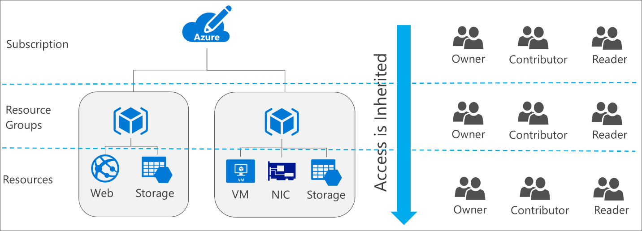



Role Based Access Control
RBAC is capability for you to grant appropriate access to Azure AD Users, groups and services.

Slide 20
RBAC Roles
Owner – Owner can manage everything, including the access
Contributor – Manage everything except access
Reader – Readers can view everything but cannot make changes

Slide 21
Users and Groups

Slide 22
User
Users who require access to resources must have a user account.
Types of Identities:
Cloud Identities – User that only exist in Azure AD Ex: Admin account
Directory-synchronized identities – Users brought into the Azure through a synchronization activity using Azure AD Connect.
Guest User – Users from outside Azure. Ex: abc@gmail.com

Slide 23
Group
Helps organize users to make it easier to manage permissions.
Two Types:
Security Group – Security Enabled and is used to assign the permissions.
Distribution Group – Used mainly by email applications and not security enabled.

Slide 25























R
RG
R
R
S
RG
R
R
R
RG
R

